Slide 1
Automated Web Performance Testing Before 5pm
Ian White
Mark Watson
Simon Nicoud

Slide 2
Build it with us!
CD’s with the required files on them are being passed around
Also available here, bandwidth permitting:
  http://bit.ly/llxuoe

Slide 3
Agenda
Automated web performance testing?
Tools needed to automate web testing
Tools used to gather Performance Metrics
Combine the two
5pm!

Slide 4
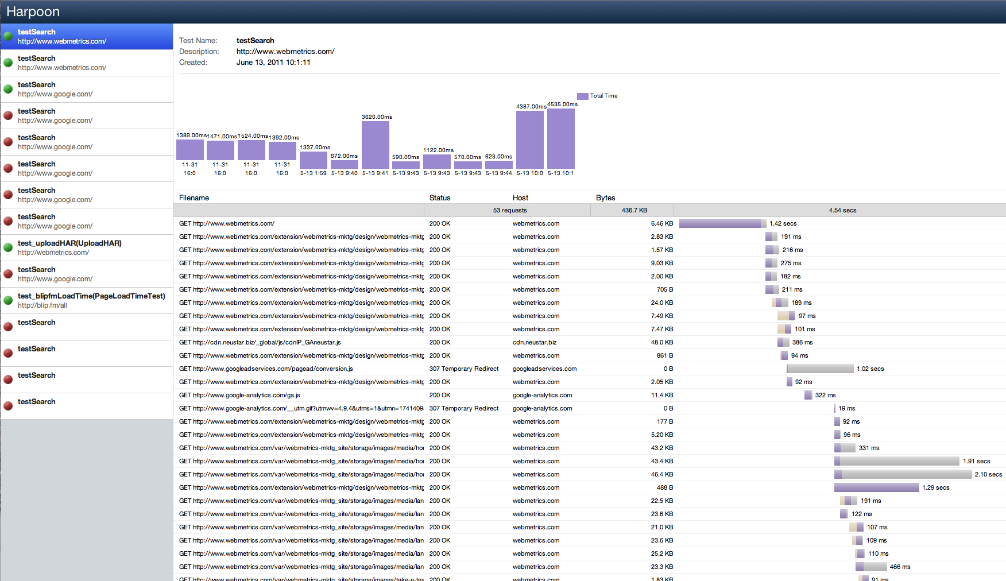
End Goal

Slide 5
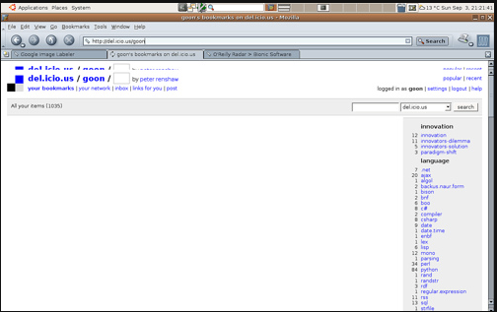

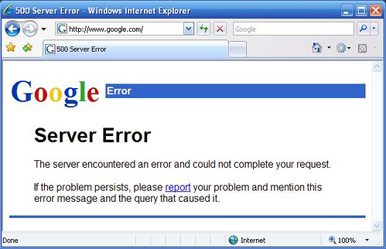
What is automated web performance testing?

Slide 6

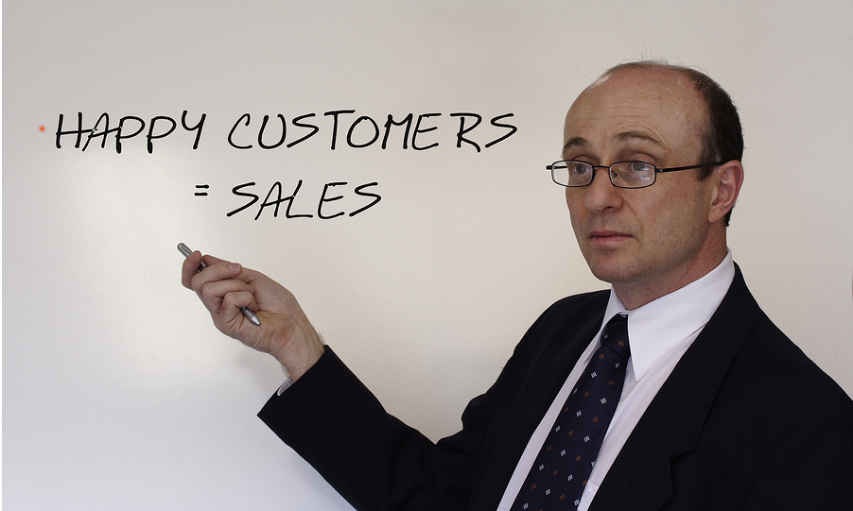
Why?

Slide 7
Tools:
Browser automation software
  Selenium (Watir, QTP, Silk Performer…)
Metrics gathering software
  BrowserMob Proxy (Fiddler, Web/Resource Timings…)
HAR Viewer – Metrics displaying software

Slide 8
Workshop Setup
Tutorials are provided in Python & Java
  Selenium to automate Firefox
  Then later use Proxy to gather page metrics
If you get lost check the READMEs!

Slide 9
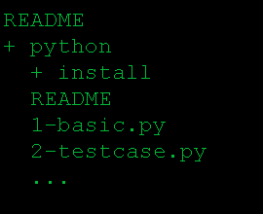
Workshop Setup
Uses Firefox
Python Examples
  Setup Python
  Setup Selenium lib
  Run example

Slide 10
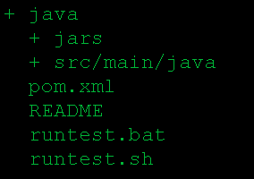
Workshop Setup
Java Examples
  Requires JDK
Selenium lib in jars/
Use runtest.sh/bat to run
README lists examples

Slide 11
Examples
Basic Selenium script
Selenium script in a unit test
Timings and Timeouts per step

Slide 12
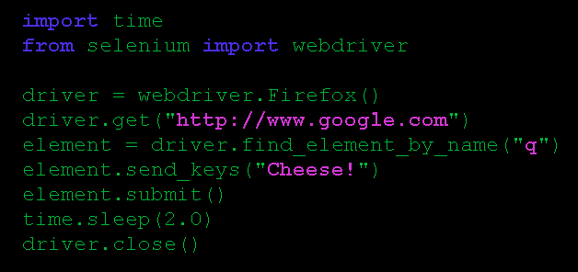
Basic Selenium script
Python:
from selenium import webdriver
driver = webdriver.Firefox()
driver.get("http://www.google.com")
element = driver.find_element_by_name("q")
element.send_keys("Cheese!")
element.submit()
driver.close()

Slide 13
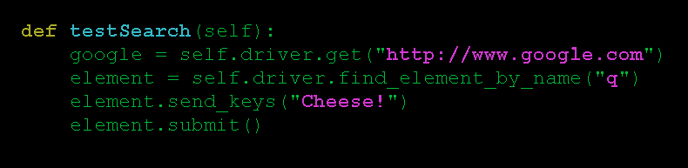
Selenium unit test
Python:
def testSearch(self):
google = self.driver.get("http://www.google.com")
element = self.driver.find_element_by_name("q")
element.send_keys("Cheese!")
element.submit()

Slide 14
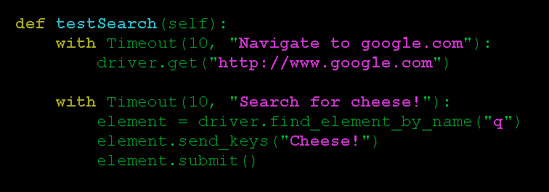
Timings and Timeouts
Python:
def testSearch(self):
with Timeout(10, "Navigate to google.com"):
self.driver.get("http://www.google.com")
with Timeout(10, "Search for cheese!"):
element =self.driver.find_element_by_name("q")
element.send_keys("Cheese!")
element.submit()

Slide 15
HAR
HTTP Archive
  Simple format (JSON/JSONP)
  Tons of data (if you want it)
  Easily extensible
  Becoming the standard

Slide 16
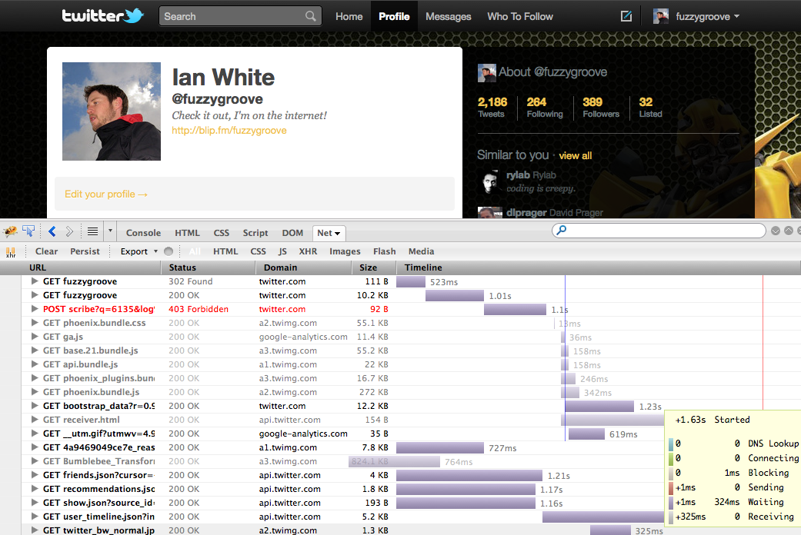
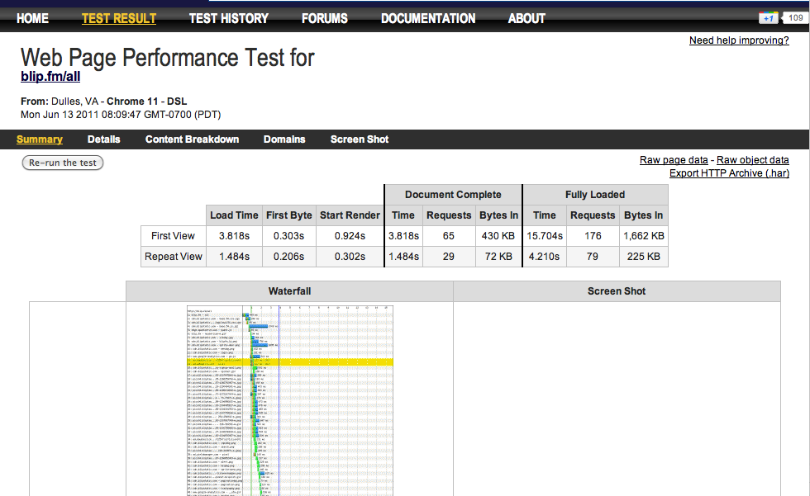
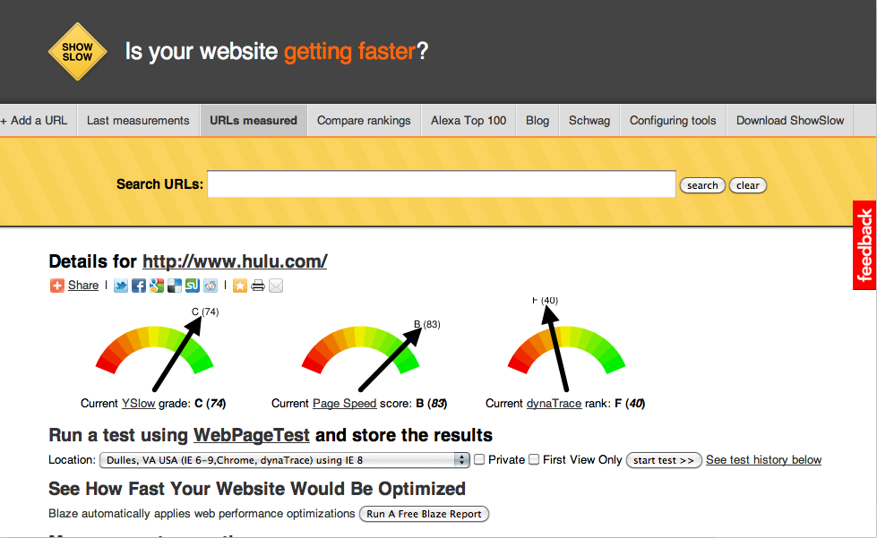
HAR Tools

Slide 17
Harpoon
Store/analyze performance test results (HAR)
Open Source
  Guice
  Sitebricks
  MongoDB
  Jetty
Built in a day (sort of)
Source code available: https://github.com/fuzzygroove/harpoon

Slide 18
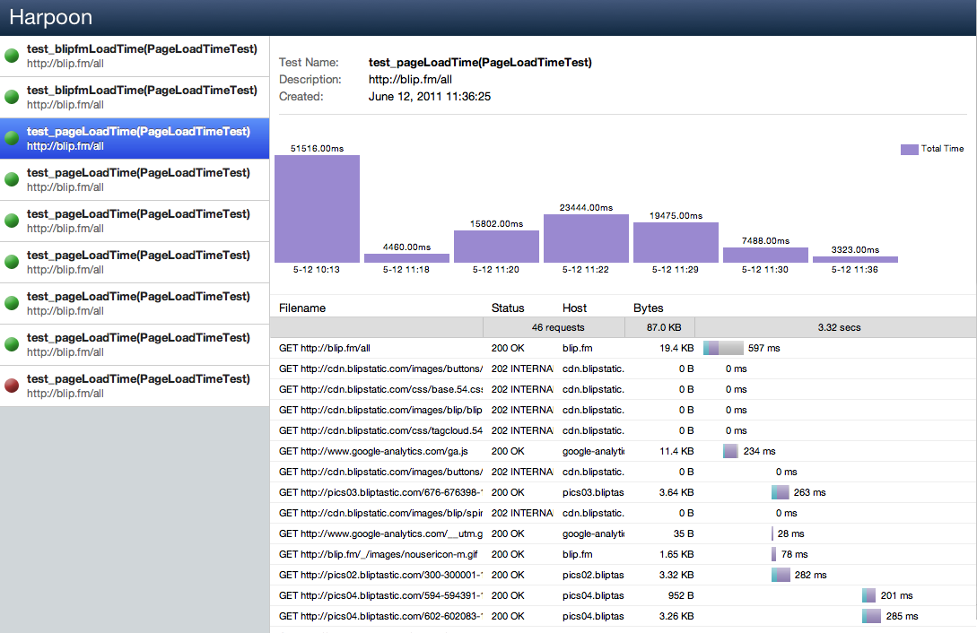
Harpoon
http://labs.webmetrics.com:8080/

Slide 19
Which Metrics?
Overall page load time
DOM loading/interactive/complete, browser 1st render, …
Per-item timings
Headers, status codes, and content

Slide 20
Methods for gathering metrics
Setting your own timings in test code
Using the new ‘Navigation.Timings’ or Web Timings standard built into browsers
Using browser plugins that report back the timings to you, e.g. WebPageTest
Routing the browser traffic through a local proxy and gathering the statistics from there.
Network traffic capture

Slide 21
Web Timings
  Currently Chrome and IE9 supported, coming soon for firefox
  http://w3c-test.org/webperf/specs/NavigationTiming/

Slide 22
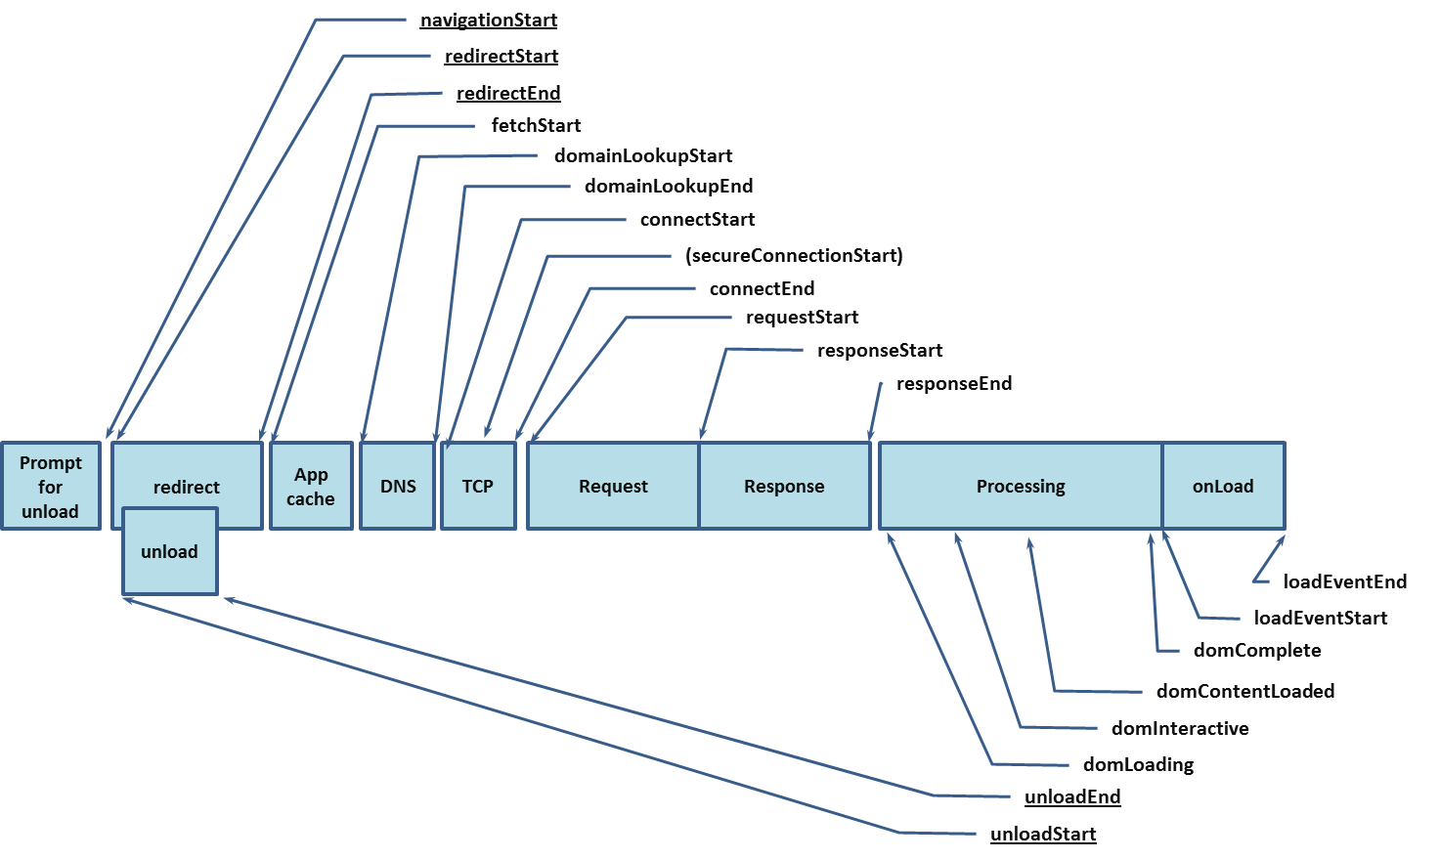
Unfortunately it doesn't give timings per item downloaded, e.g. images, css, js, ....

Slide 23
Browser Plugins
Firefox - Firebug Net Panel + NetExport
    https://github.com/lightbody/browsermob-page-perf
    https://github.com/AutomatedTester/AutomatedTester.PagePerf.git

Slide 24
Capturing page metrics using a proxy
Many available, but few capture metrics in a convenient way
  Two good ones we’ll be looking at:
    BrowserMob Proxy
    Fiddler

Slide 25
Advantages of using a Proxy
Works with any browser that allows setting a proxy
Testing benefits beyond performance monitoring
  Blacklisting/whitelisting URLs
  URL rewrites
  Make sure specific URLs are visited

Slide 26
Advantages of using a Proxy
Header changes
  Set the user agent manually to test different browser behavior
  Auto authentication
Wait until all content is downloaded
  HTTP idle for X seconds
Simulate limited bandwidth

Slide 27
BrowserMob Proxy
Open source cross platform proxy
  HTTP Archive support
  Native Java API
  REST API for calling from other languages
Source code available:
  https://github.com/lightbody/browsermob-proxy

Slide 28
BrowserMob Proxy
Java Examples:
  Write out HTTP Archive file
  Separate pages in the HAR
proxy.getHar().writeTo(new File("test.har"));
proxy.newHar(“Main Page”);
...load main page...
proxy.endPage();
proxy.newPage(”Login");
...login...
proxy.endPage();

Slide 29
BrowserMob Proxy
Blacklist/Whitelist URLs
proxy.blacklistRequests(regex, responseCode)
proxy.whitelistRequests(regex, responseCode)
Limit Bandwidth
proxy.setDownstreamKbps(kbps)
proxy.setUpstreamKbps(kbps)
Redirecting URLs
proxy.rewriteUrl(regex, replace)

Slide 30

BrowserMob Proxy
Python Demo:
  First, start the proxy:
  Then, run the examples:

Slide 31
BrowserMob Proxy
Selenium test with HAR export

Slide 32

BrowserMob Proxy
Whitelist example
  Compare site load time with and without 3rd party content

Slide 33

BrowserMob Proxy
Limit Bandwidth
  Compare site load time with different bandwidth restrictions

Slide 34

BrowserMob Proxy
HAR upload
  Last example uploads results of each test to central server.

Slide 35
Optimize for Testing
Dumb stuff
  Don’t use nested iframes
  Avoid popups
Tough stuff
  Dynamic elements
  Embedded objects
  Mobile
Good stuff
  Automated test framework
  Continuous Integration

Slide 36

Links
BrowserMob proxy
  https://github.com/lightbody/browsermob-proxy
Harpoon
  https://github.com/fuzzygroove/harpoon
Examples from this talk
  https://github.com/watsonmw/automated-pageloadmetrics
Simon Nicoud: simon.nicoud@neustar.biz - @simonnicoud
Ian White: ian.white@neustar.biz - @impressiver
Mark Watson: mark.watson@neustar.biz - @watsonmw

